Slide 1
Chapter
Outline
13.1 Transport-Layer Services
13.2 Transport-Layer Protocols
TCP/IP Protocol Suite

Slide 2
13-1 TRANSPORT-LAYER SERVICES
As we discussed in Chapter 2, the transport layer is located between the network layer and the application layer. The transport layer is responsible for providing services to the application layer; it receives services from the network layer. In this section, we discuss the services that can be provided by a transport layer; in the next section, we discuss the principle beyond several transport layer protocols.
TCP/IP Protocol Suite

Slide 3
Topics Discussed in the Section
Process-to-Process Communication
Addressing: Port Numbers
Encapsulation and Decapsulation
Multiplexing and Demultiplexing
Flow Control
Error Control
Congestion Control
Connectionless and Connection-Oriented Services
TCP/IP Protocol Suite

Slide 4
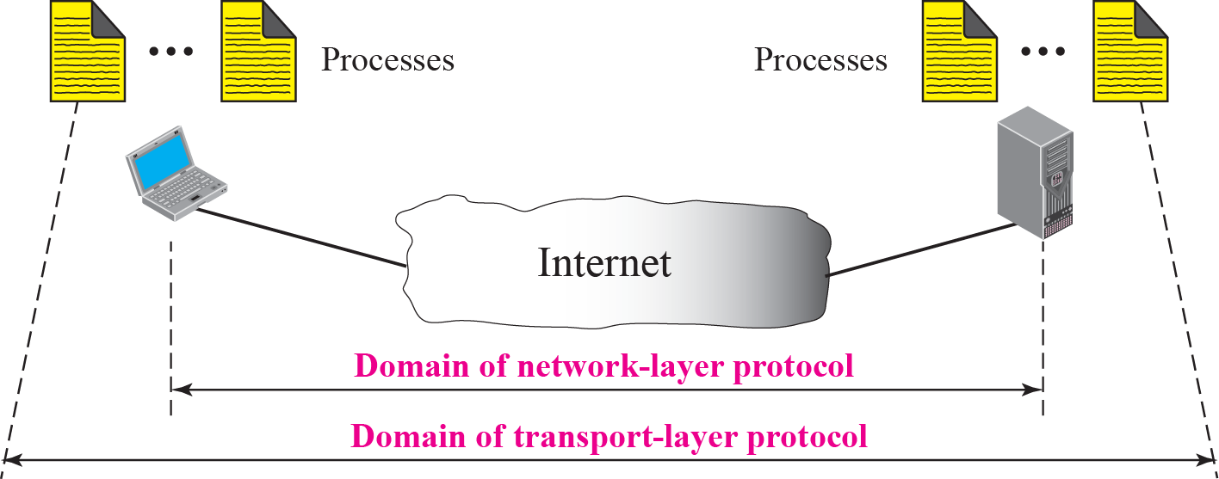
Figure 13.1 Network layer versus transport layer
TCP/IP Protocol Suite

Slide 5
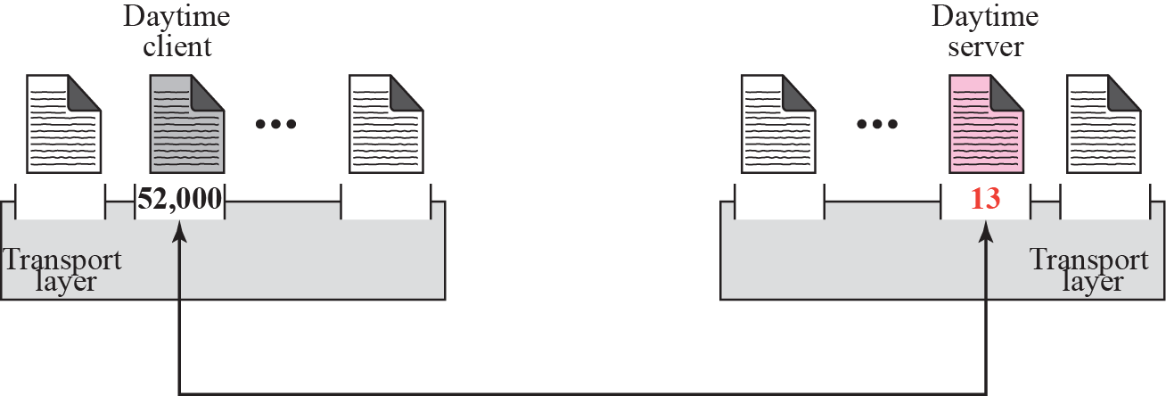
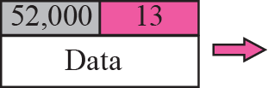
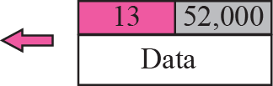
Figure 13.2 Port numbers
TCP/IP Protocol Suite

Slide 6
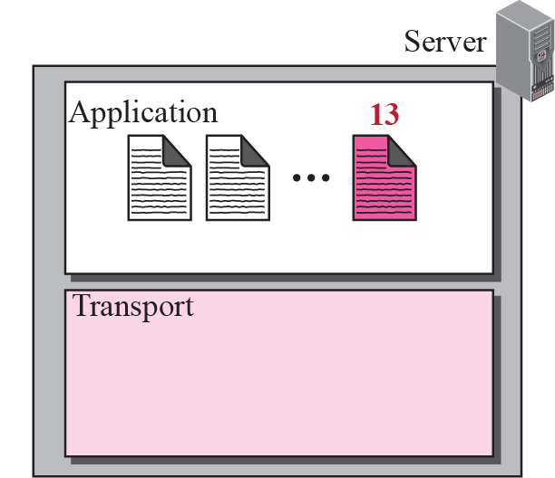
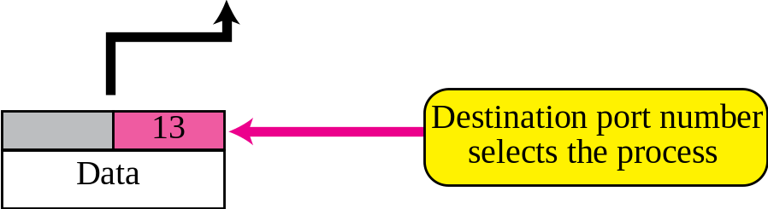
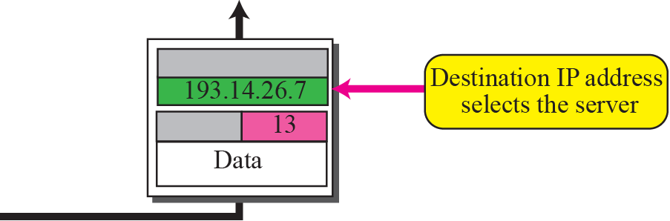
Figure 13.3 IP addresses versus port numbers
TCP/IP Protocol Suite

Slide 7
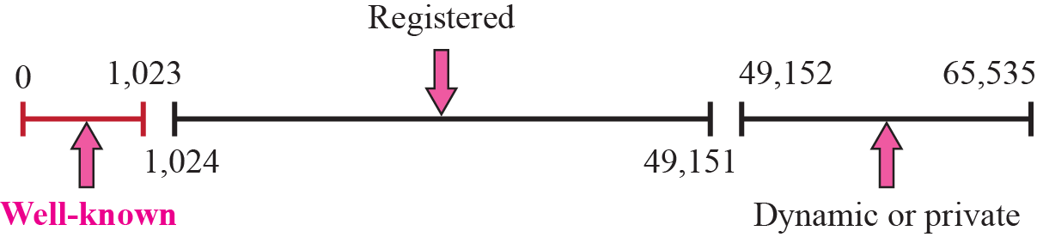
Figure 13.4 ICANN ranges
TCP/IP Protocol Suite

Slide 8

Note
The well-known port numbers are
less than 1,024.
TCP/IP Protocol Suite

Slide 9
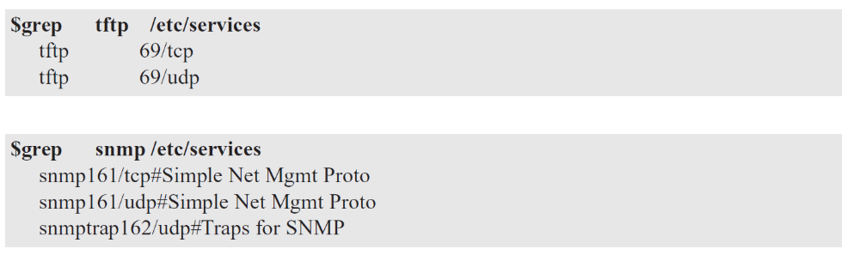
Example 13.1
In UNIX, the well-known ports are stored in a file called /etc/services. Each line in this file gives the name of the server and the well-known port number. We can use the grep utility to extract the line corresponding to the desired application. The following shows the port for TFTP. Note that TFTP can use port 69 on either UDP or TCP. SNMP (see Chapter 24) uses two port numbers (161 and 162), each for a different purpose.
TCP/IP Protocol Suite

Slide 10
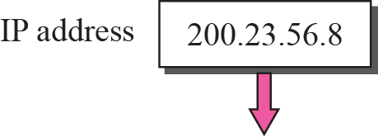
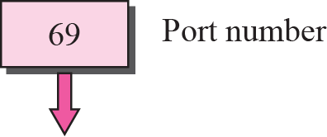

Figure 13.5 Socket address
TCP/IP Protocol Suite

Slide 11
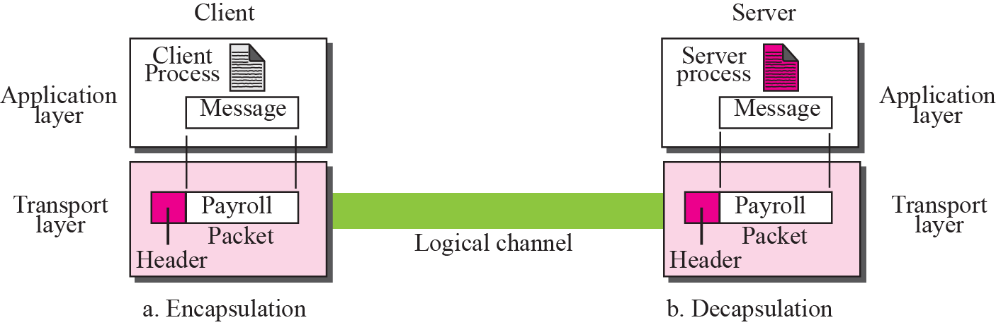
Figure 13.6 Encapsulation and decapsulation
TCP/IP Protocol Suite

Slide 12
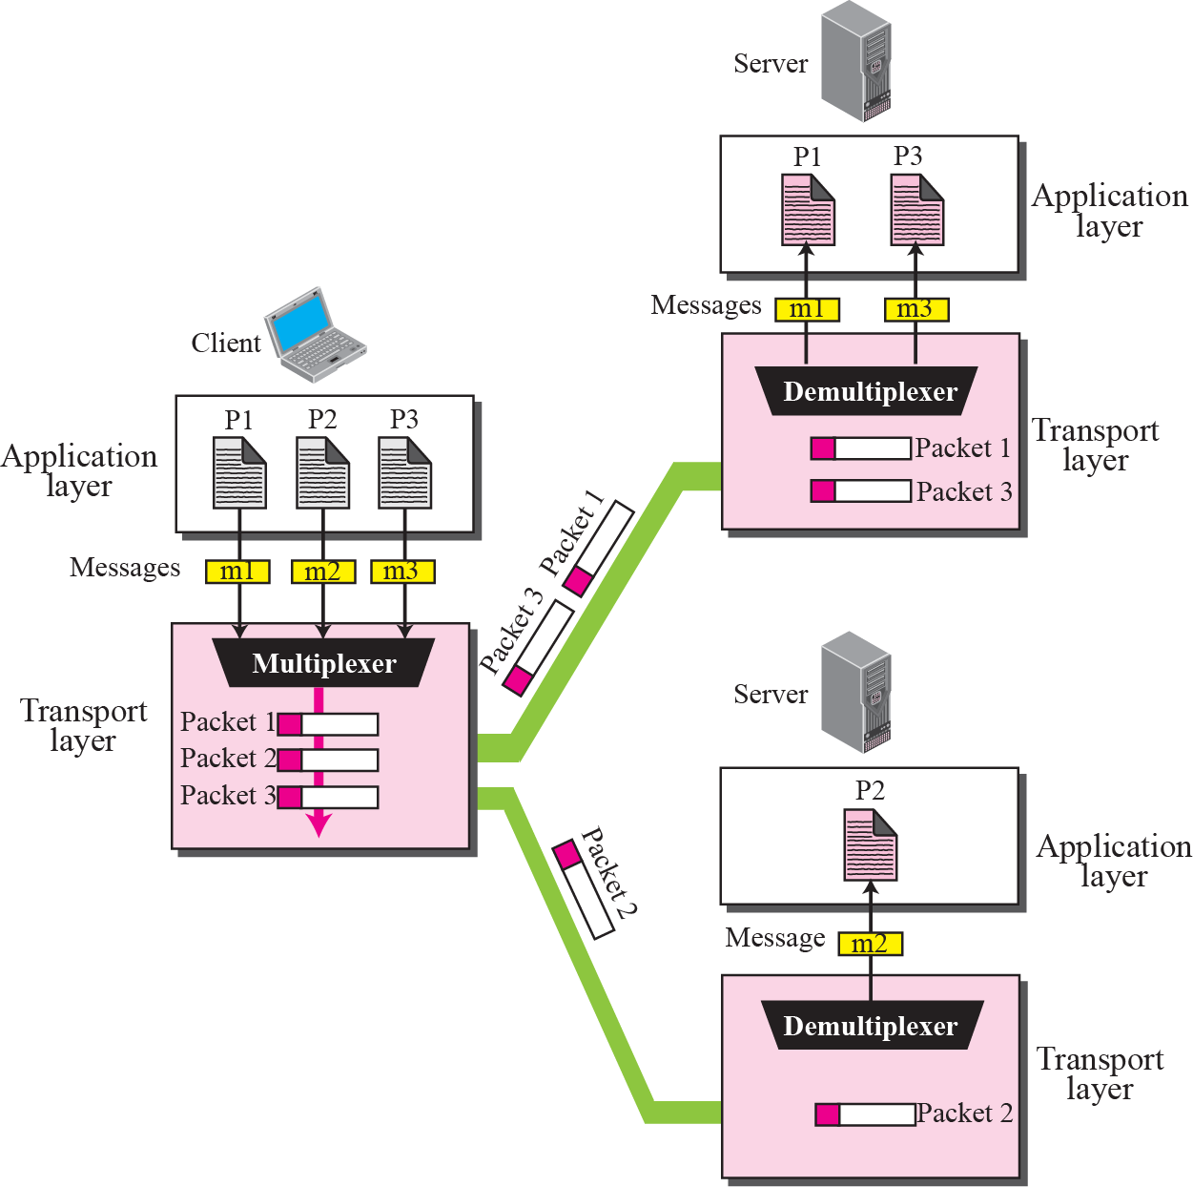
Figure 13.7 Multiplexing and demultiplexing
TCP/IP Protocol Suite

Slide 13
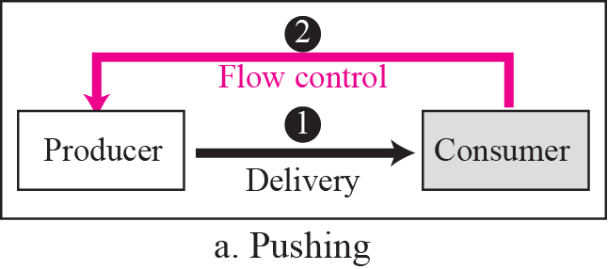
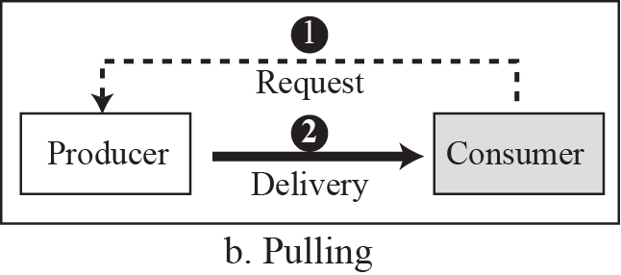
Figure 13.8 Pushing or pulling
TCP/IP Protocol Suite

Slide 14
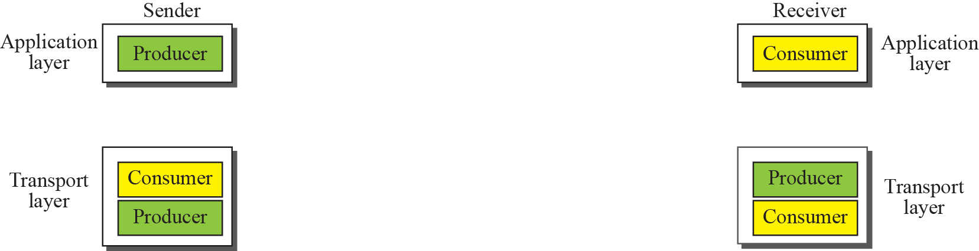
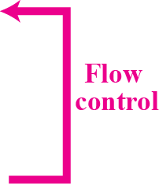
Figure 13.9 Flow control at the transport layer
TCP/IP Protocol Suite

Slide 15
Example 13.2
The above discussion requires that the consumers communicate with the producers in two occasions: when the buffer is full and when there are vacancies. If the two parties use a buffer of only one slot, the communication can be easier. Assume that each transport layer uses one single memory location to hold a packet. When this single slot in the sending transport layer is empty, the sending transport layer sends a note to the application layer to send its next chunk; when this single slot in the receiving transport layer is empty, it sends an acknowledgment to the sending transport layer to send its next packet. As we will see later, this type of flow control, using a single-slot buffer at the sender and the receiver, is inefficient.
TCP/IP Protocol Suite

Slide 16
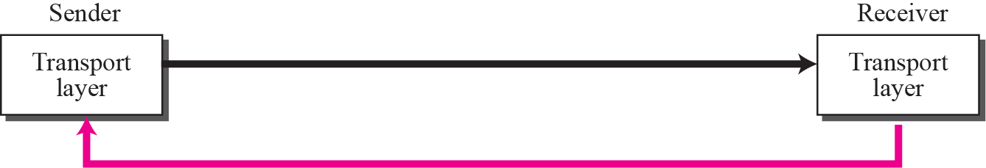
Figure 13.10 Error control at the transport layer
Packets
Error Control
TCP/IP Protocol Suite

Slide 17
Note
For error control, the sequence numbers are modulo 2^{m}, where m is the size of the sequence number field in bits.
TCP/IP Protocol Suite

Slide 18
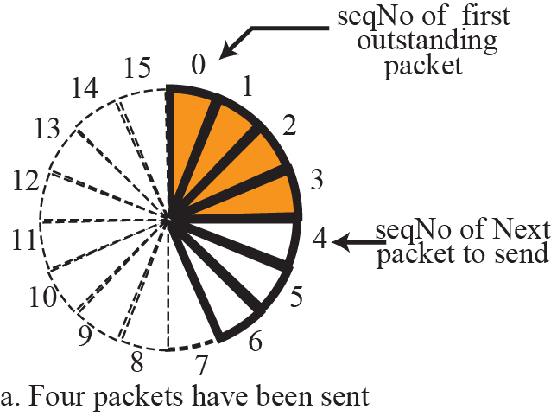
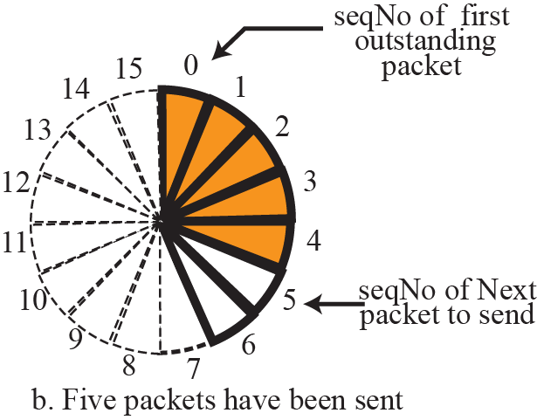
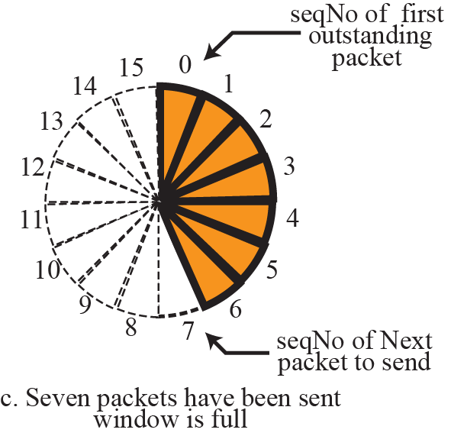
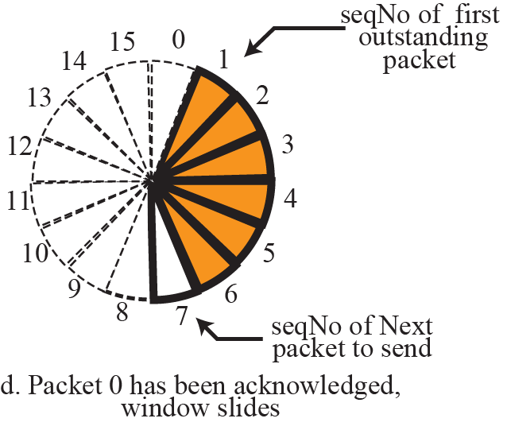
Figure 13.11 Sliding window in circular format
TCP/IP Protocol Suite

Slide 19
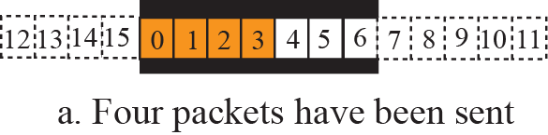
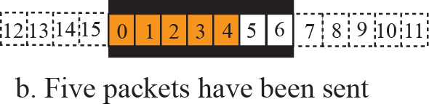
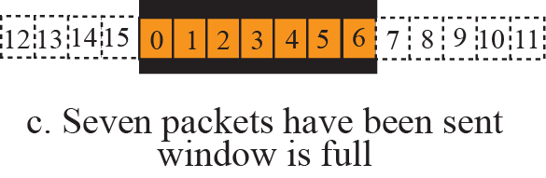
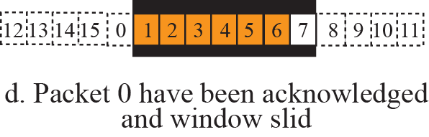
Figure 13.12 Sliding window in linear format
TCP/IP Protocol Suite

Slide 20
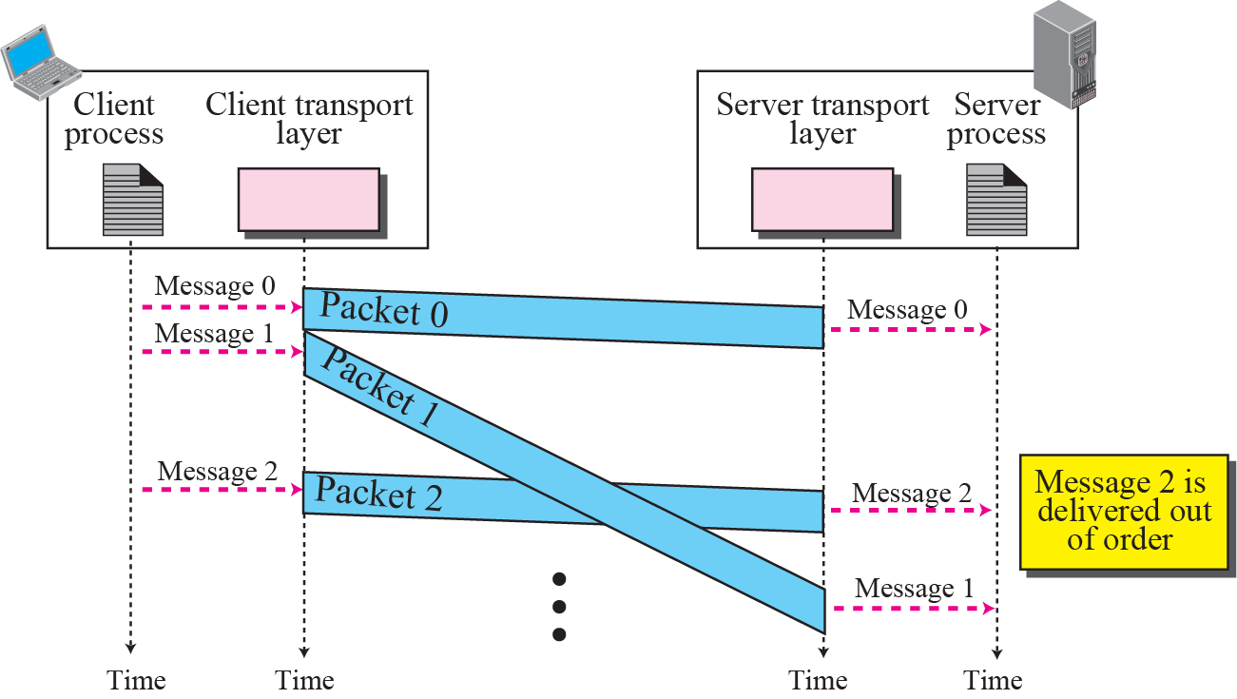
Figure 13.13 Connectionless service
TCP/IP Protocol Suite

Slide 21
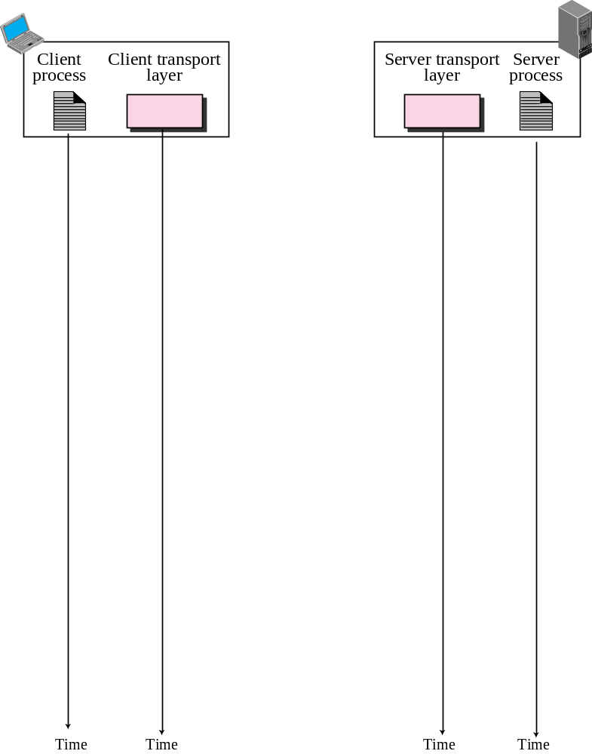
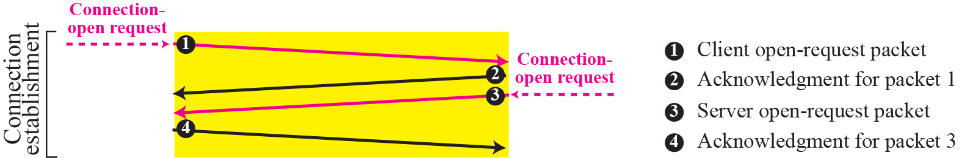
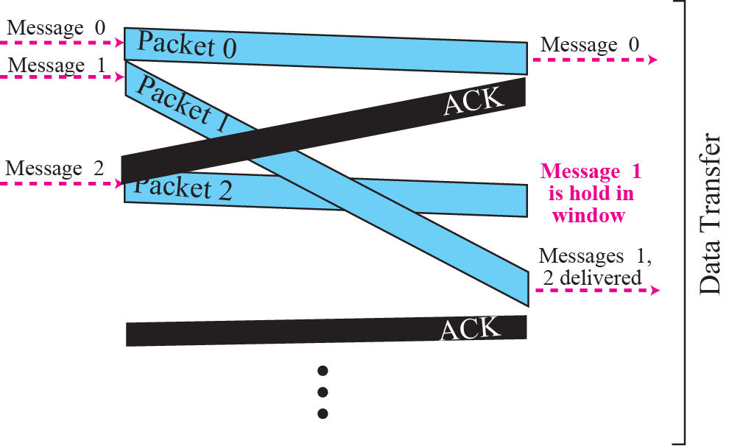
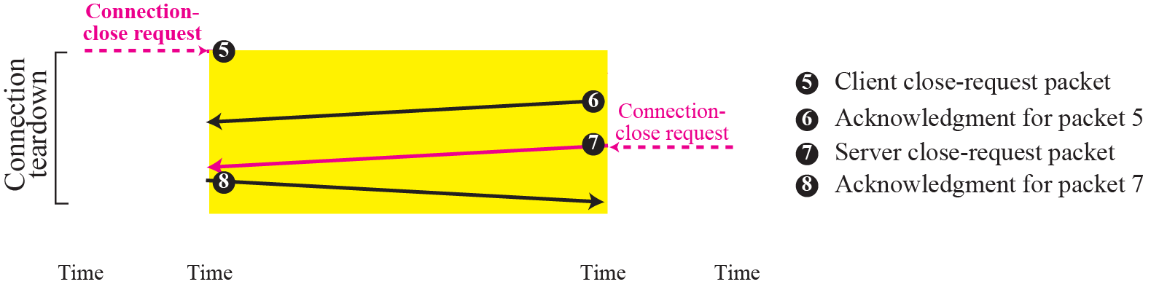
Figure 13.14 Connection-oriented service
TCP/IP Protocol Suite

Slide 22
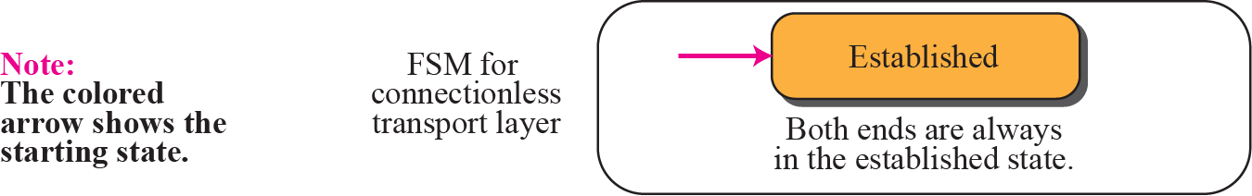
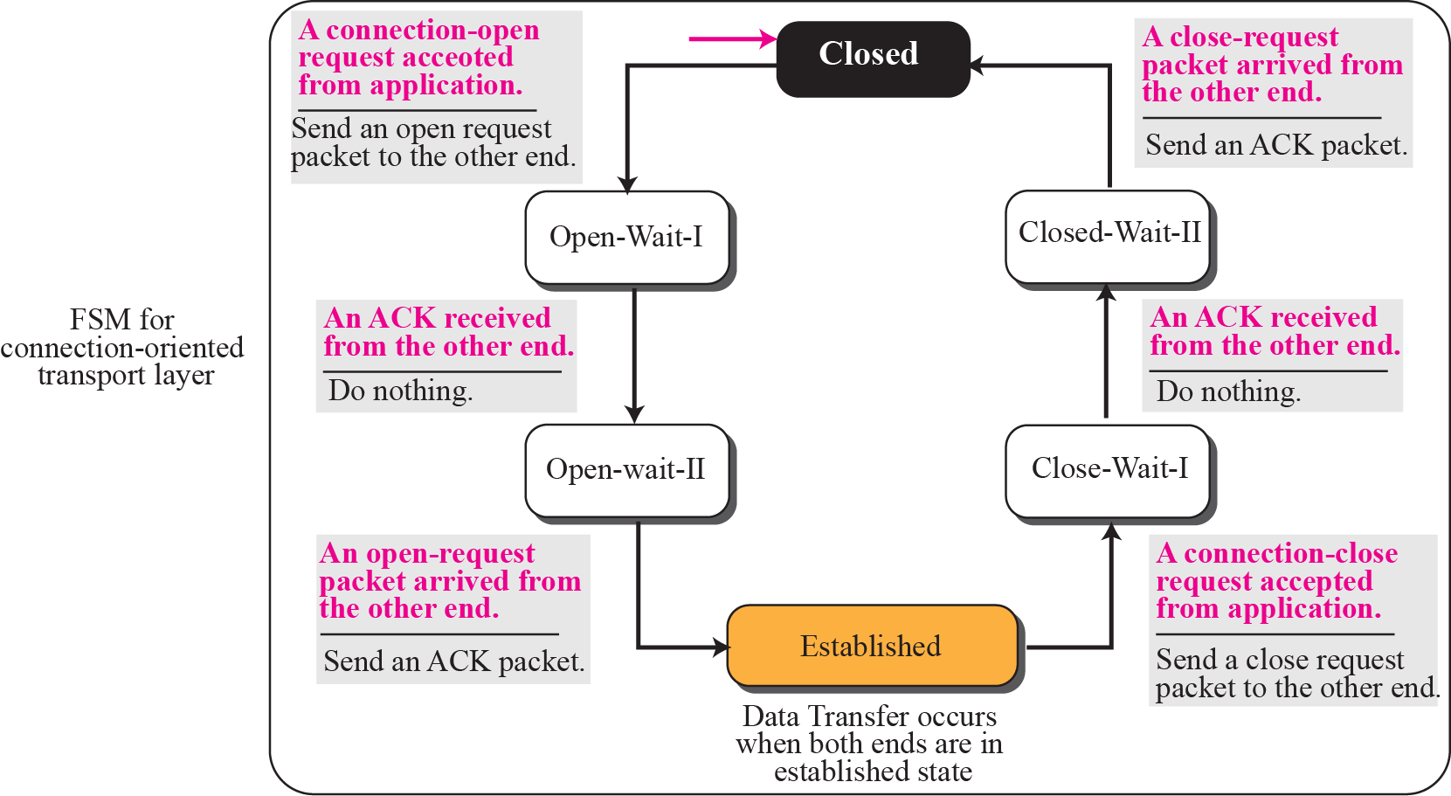
Figure 13.15 Connectionless and connection-oriented services as FSMs
TCP/IP Protocol Suite

Slide 23
13-2 TRANSPORT-LAYER PROTOCOLS
We can create a transport-layer protocol by combining a set of services described in the previous sections. To better understand the behavior of these protocols, we start with the simplest one and gradually add more complexity. The TCP/IP protocol uses a transport layer protocol that is either a modification or a combination of some of these protocols.
TCP/IP Protocol Suite

Slide 24
Topics Discussed in the Section
Simple Protocol
Stop-and-Wait Protocol
Go-Back-N Protocol
Selective-Repeat Protocol
Bidirectional Protocols: Piggybacking
TCP/IP Protocol Suite

Slide 25
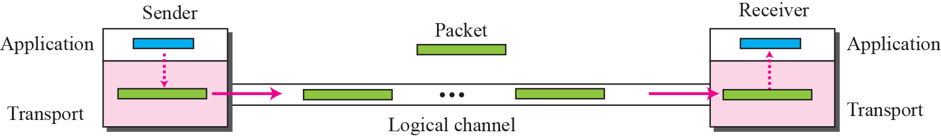
Figure 13.16 Simple protocol
TCP/IP Protocol Suite

Slide 26
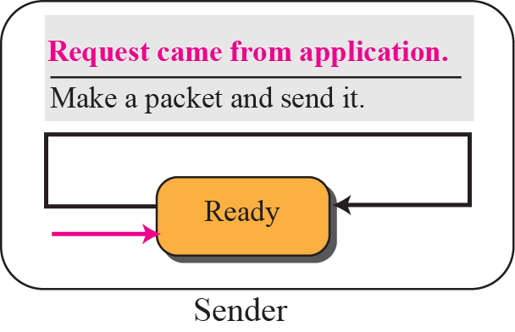
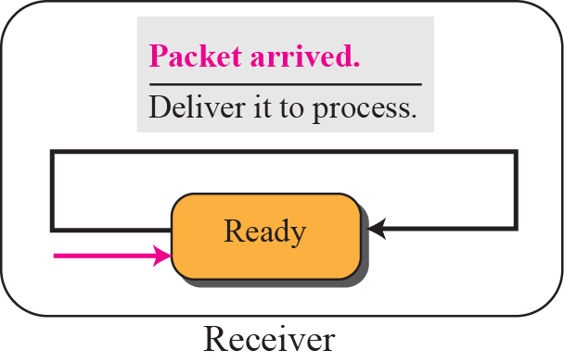
Figure 13.17 FSMs for simple protocol
TCP/IP Protocol Suite

Slide 27
Note
The simple protocol is a connectionless protocol that provides neither
flow nor error control.
TCP/IP Protocol Suite

Slide 28
Example 13.3
Figure 13.18 shows an example of communication using this protocol. It is very simple. The sender sends packets one after another without even thinking about the receiver.
TCP/IP Protocol Suite

Slide 29
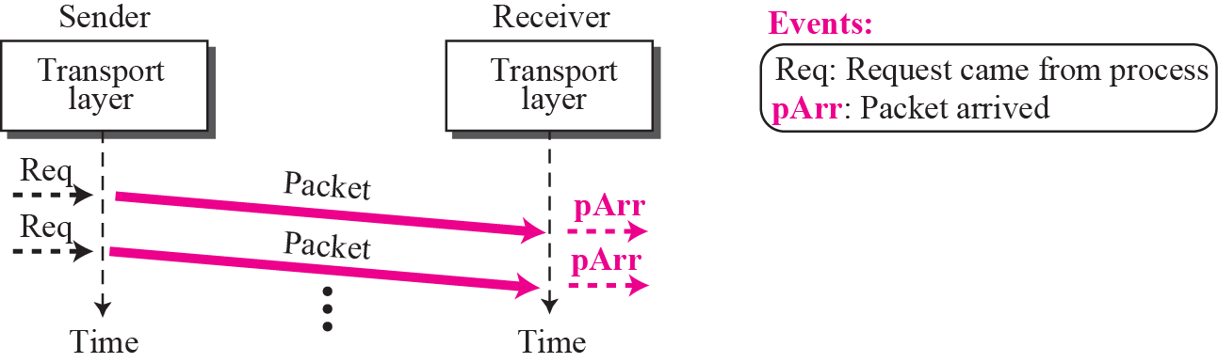
Figure 13.18 Example 13.3
TCP/IP Protocol Suite

Slide 30
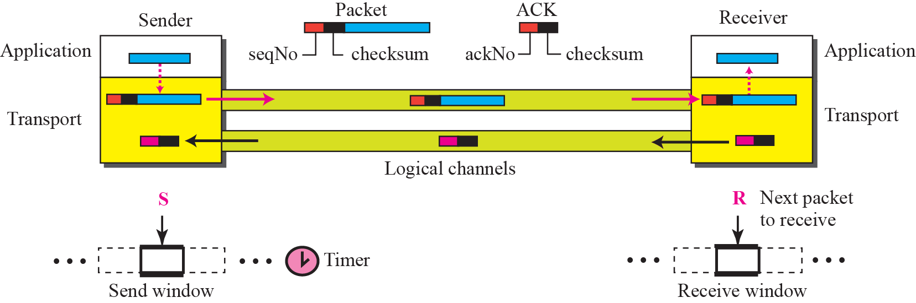
Figure 13.19 Stop-and-wait protocol
TCP/IP Protocol Suite

Slide 31
Note
In Stop-and-Wait protocol, flow
control is achieved by forcing the sender to wait for an acknowledgment, and error control is achieved by discarding corrupted packets and letting the sender resend unacknowledged packets when the timer expires.
TCP/IP Protocol Suite

Slide 32
Note
In the Stop-and-Wait protocol, we can use a 1-bit field to number the packets. The sequence numbers are based on modulo-2 arithmetic.
TCP/IP Protocol Suite

Slide 33
Note
In the Stop-and-Wait protocol, the acknowledgment number always announces in modulo-2 arithmetic the sequence number of the next packet expected.
TCP/IP Protocol Suite

Slide 34
Note
All calculation in the Stop-and-Wait protocol is in modulo 2.
TCP/IP Protocol Suite

Slide 35
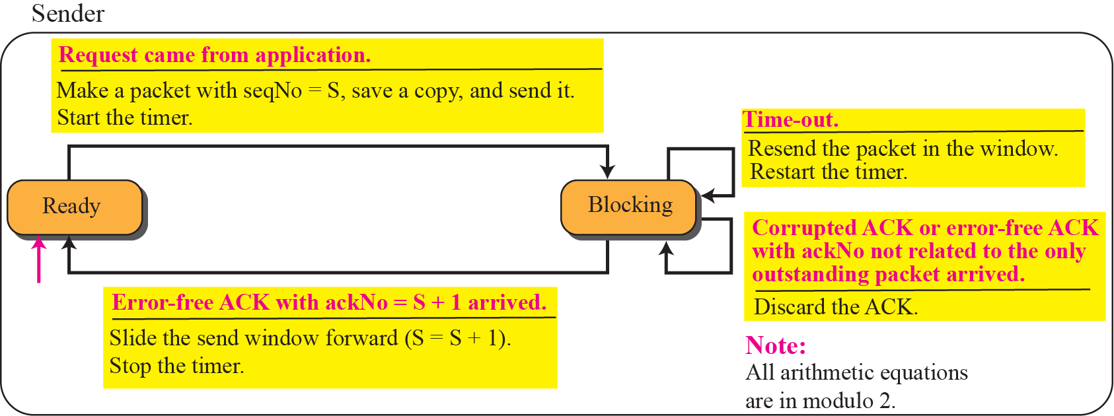
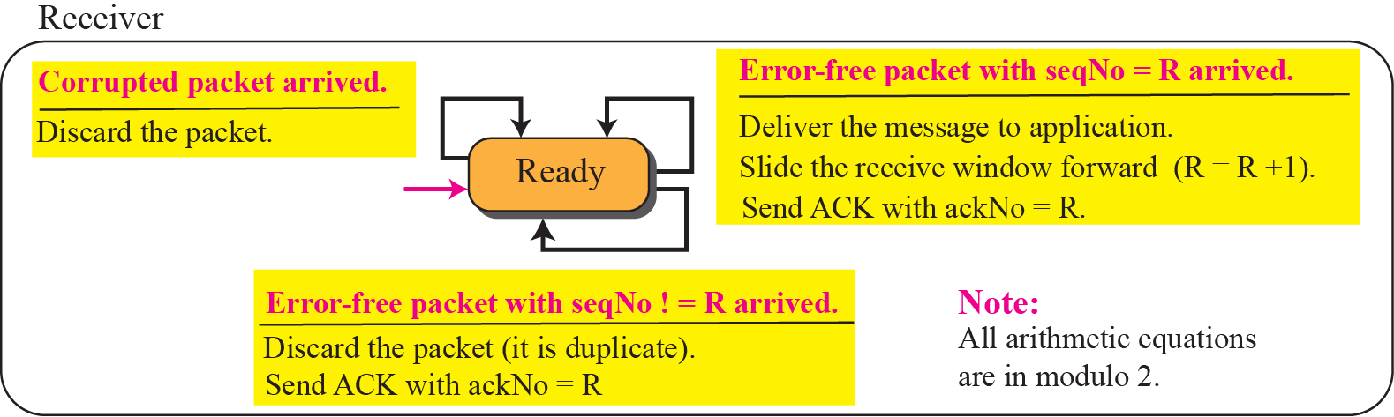
Figure 13.20 FSMs for stop-and-wait protocol
TCP/IP Protocol Suite

Slide 36
Example 13.4
Figure 13.21 shows an example of Stop-and-Wait protocol. Packet 0 is sent and acknowledged. Packet 1 is lost and resent after the time-out. The resent packet 1 is acknowledged and the timer stops. Packet 0 is sent and acknowledged, but the acknowledgment is lost. The sender has no idea if the packet or the acknowledgment is lost, so after the time-out, it resends packet 0, which is acknowledged.
TCP/IP Protocol Suite

Slide 37
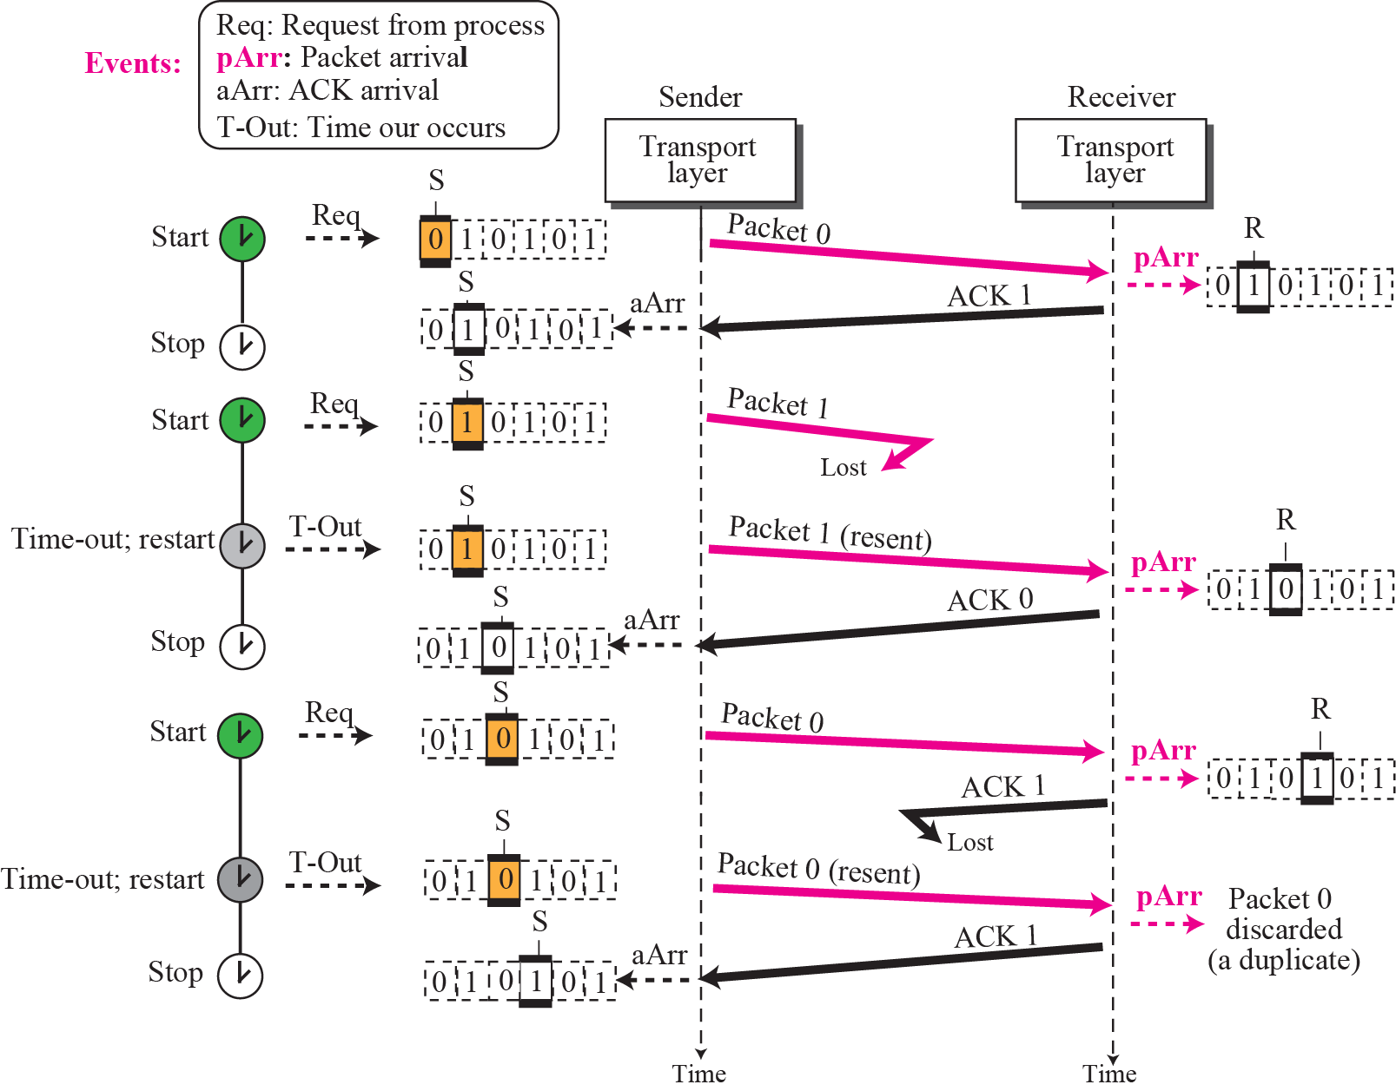
Figure 13.21 Example 13.4
TCP/IP Protocol Suite

Slide 38
Example 13.5
Assume that, in a Stop-and-Wait system, the bandwidth of the line is 1 Mbps, and 1 bit takes 20 milliseconds to make a round trip. What is the bandwidth-delay product? If the system data packets are 1,000 bits in length, what is the utilization percentage of the link?
Solution
The bandwidth-delay product is (1 × 10⁶) × (20 × 10⁻³) = 20,000 bits. The system can send 20,000 bits during the time it takes for the data to go from the sender to the receiver and the acknowledgment to come back. However, the system sends only 1,000 bits. We can say that the link utilization is only 1,000/20,000, or 5 percent. For this reason, for a link with a high bandwidth or long delay, the use of Stop-and-Wait wastes the capacity of the link.
TCP/IP Protocol Suite

Slide 39
Example 13.6
What is the utilization percentage of the link in Example 13.5 if we have a protocol that can send up to 15 packets before stopping and worrying about the acknowledgments?
Solution
The bandwidth-delay product is still 20,000 bits. The system can send up to 15 packets or 15,000 bits during a round trip. This means the utilization is 15,000/20,000, or 75 percent. Of course, if there are damaged packets, the utilization percentage is much less because packets have to be resent.
TCP/IP Protocol Suite

Slide 40
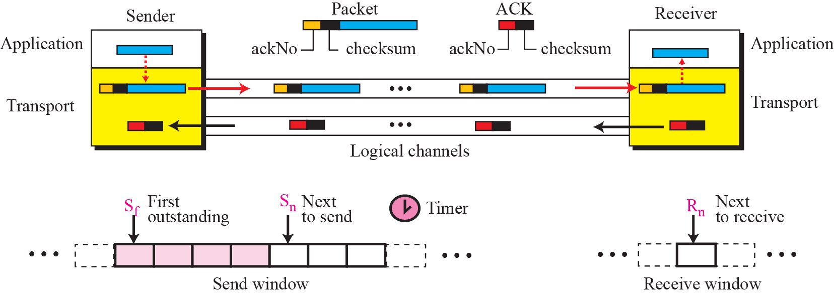
Figure 13.22 Go-Back-N protocol
TCP/IP Protocol Suite

Slide 41
Note
In the Go-Back-N Protocol, the sequence numbers are modulo 2^{m}, where m is the size of the sequence number
field in bits.
TCP/IP Protocol Suite

Slide 42
Note
In the Go-Back-N protocol, the acknowledgment number is
cumulative and defines the sequence number of the next packet
expected to arrive.
TCP/IP Protocol Suite

Slide 43
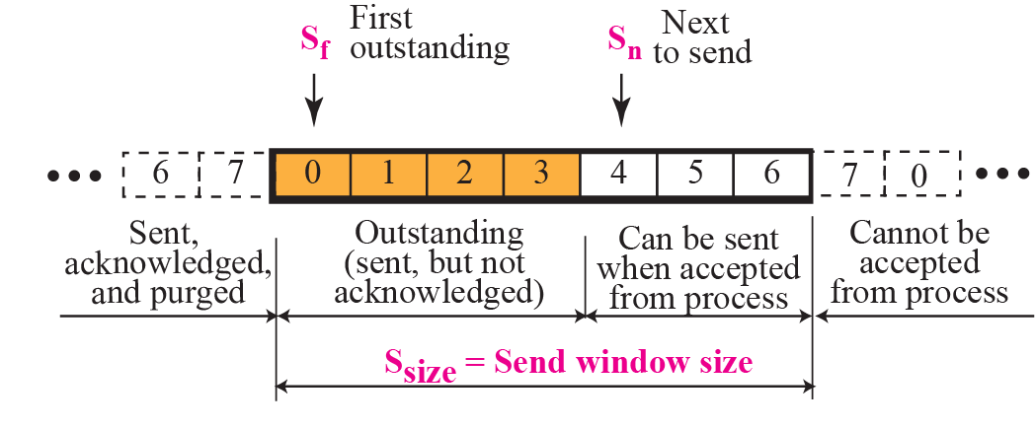
Figure 13.23 Send window for Go-Back-N
TCP/IP Protocol Suite

Slide 44
Note
The send window is an abstract concept defining an imaginary box of maximum
size = 2^{m} − 1 with three variables:
S_{f}, S_{n}, and S_{size}.
TCP/IP Protocol Suite

Slide 45
Note
The send window can slide one or
more slots when an error-free ACK
with ackNo between S_{f} and S_{n}
(in modular arithmetic) arrives.
TCP/IP Protocol Suite

Slide 46
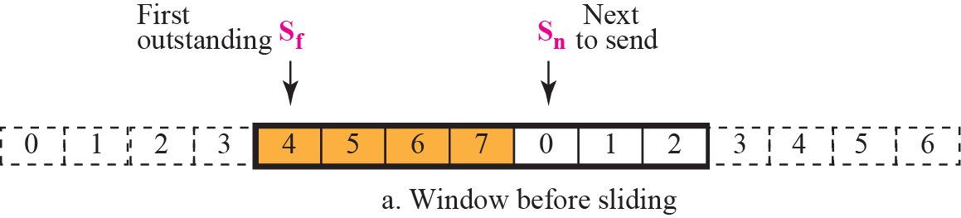
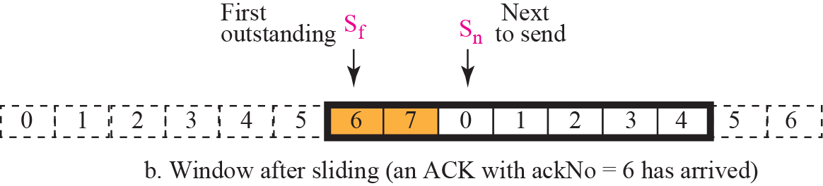
Figure 13.24 Sliding the send window
TCP/IP Protocol Suite

Slide 47
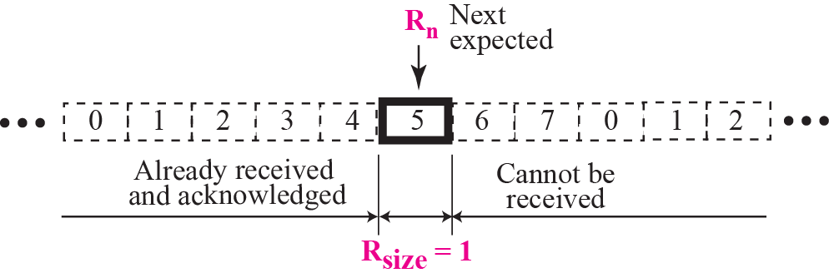
Figure 13.25 Receive window for Go-Back-N
TCP/IP Protocol Suite

Slide 48
Note
The receive window is an abstract concept defining an imaginary
box of size 1 with
one single variable R_{n}.
The window slides when a correct packet has arrived; sliding
occurs one slot at a time.
TCP/IP Protocol Suite

Slide 49
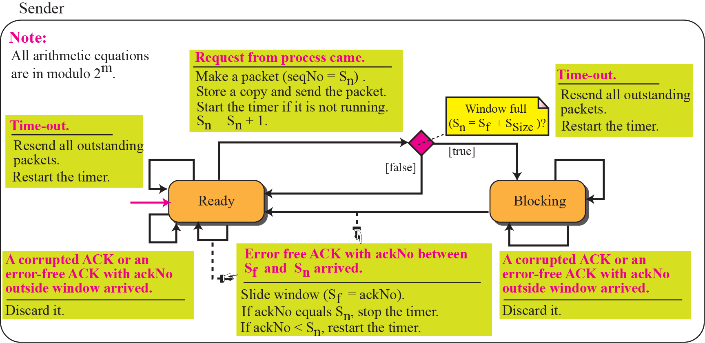
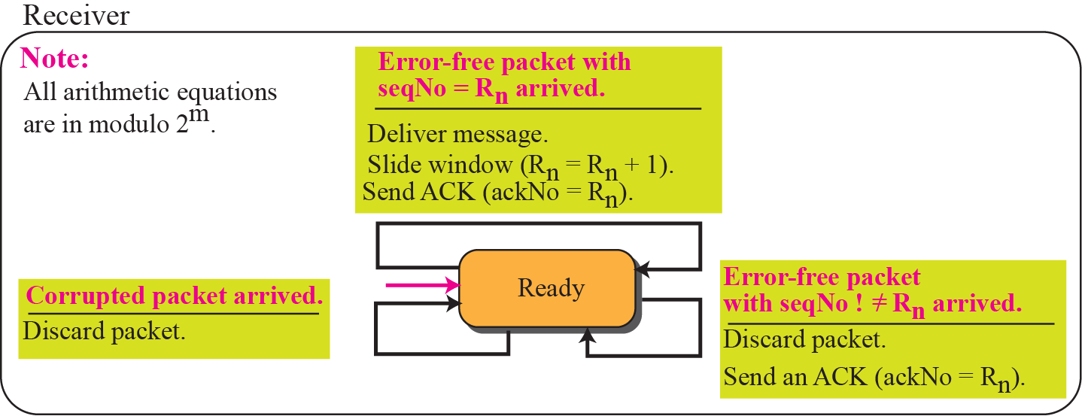
Figure 13.26 FSMs for Go-Back-N
TCP/IP Protocol Suite

Slide 50
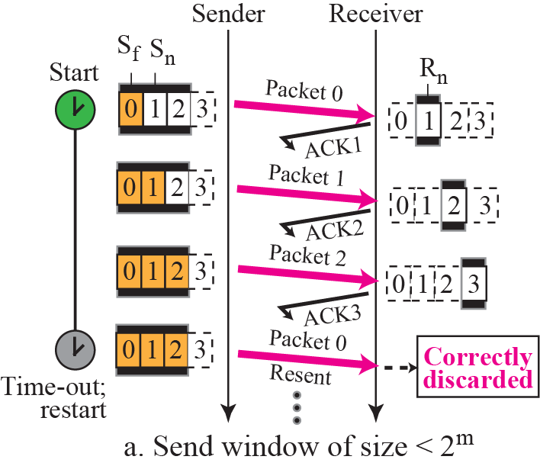
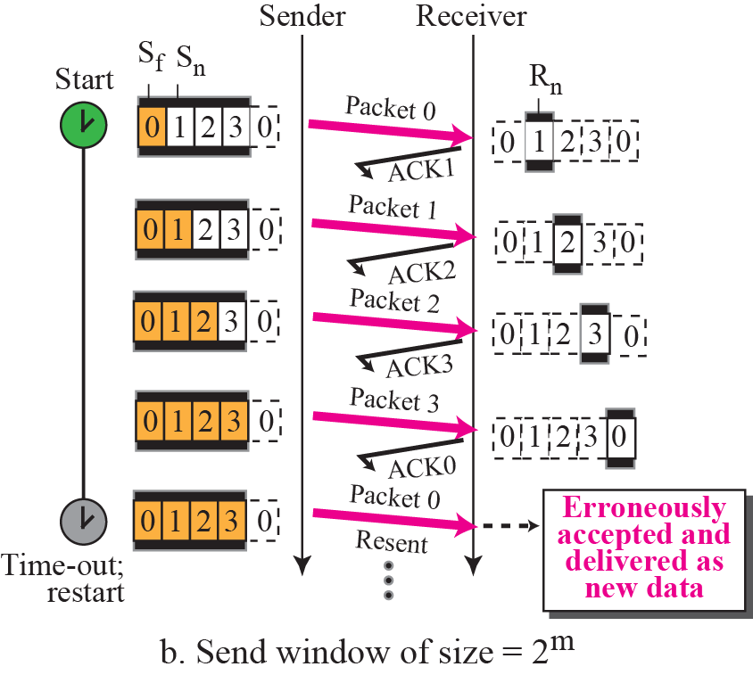
Figure 13.27 Send window size for Go-Back-N
TCP/IP Protocol Suite

Slide 51
Note
In the Go-Back-N protocol, the size of the send window must be less than 2m;
the size of the receive window
is always 1.
TCP/IP Protocol Suite

Slide 52
Example 13.7
Figure 13.28 shows an example of Go-Back-N. This is an example of a case where the forward channel is reliable, but the reverse is not. No data packets are lost, but some ACKs are delayed and one is lost. The example also shows how cumulative acknowledgments can help if acknowledgments are delayed or lost.
TCP/IP Protocol Suite

Slide 53

Figure 13.28 Example 13.7
TCP/IP Protocol Suite

Slide 54
Example 13.8
Figure 13.29 shows what happens when a packet is lost. Packets 0, 1, 2, and 3 are sent. However, packet 1 is lost. The receiver receives packets 2 and 3, but they are discarded because they are received out of order (packet 1 is expected). When the receiver receives packets 2 and 3, it sends ACK1 to show that it expects to receive packet 1. However, these ACKs are not useful for the sender because the ackNo is equal S_{f} , not greater that S_{f} . So the sender discards them. When the time-out occurs, the sender resends packets 1, 2, and 3, which are acknowledged..
TCP/IP Protocol Suite

Slide 55

Figure 13.29 Example 13.8
TCP/IP Protocol Suite

Slide 56

Figure 13.30 Outline of Selective-Repeat
TCP/IP Protocol Suite

Slide 57

Figure 13.31 Send window for Selective-Repeat protocol
TCP/IP Protocol Suite

Slide 58

Figure 13.32 Receive window for Selective-Repeat protocol
TCP/IP Protocol Suite

Slide 59
Note
In the Selective-Repeat protocol, an acknowledgment number defines
the sequence number of the
error-free packet received.
TCP/IP Protocol Suite

Slide 60
Example 13.9
Assume a sender sends 6 packets: packets 0, 1, 2, 3, 4, and 5. The sender receives an ACK with ackNo = 3. What is the interpretation if the system is using GBN or SR?
Solution
If the system is using GBN, it means that packets 0, 1, and 2 have been received uncorrupted and the receiver is expecting packet 3. If the system is using SR, it means that packet 3 has been received uncorrupted; the ACK does not say anything about other packets.
TCP/IP Protocol Suite

Slide 61


Figure 13.33 FSMs for SR protocol
TCP/IP Protocol Suite

Slide 62
Example 13.10
This example is similar to Example 3.8 (Figure 13.29) in which packet 1 is lost. We show how Selective-Repeat behaves in this case. Figure 13.34 shows the situation. At the sender, packet 0 is transmitted and acknowledged. Packet 1 is lost. Packets 2 and 3 arrive out of order and are acknowledged. When the timer times out, packet 1 (the only unacknowledged packet) is resent and is acknowledged. The send window then slides.
TCP/IP Protocol Suite

Slide 63

Figure 13.34 Example 13.10
TCP/IP Protocol Suite

Slide 64


Figure 13.35 Selective-Repeat window size
TCP/IP Protocol Suite

Slide 65
Note
In Selective-Repeat, the size of the sender and receiver window
can be at most one-half of 2m.
TCP/IP Protocol Suite

Slide 66

Figure 13.36 Design of piggybacking for Go-Back-N
TCP/IP Protocol Suite

